Slide 1
Lecture 3 Understanding the Need, Basic Guidelines, Content & Process for Value Education

Slide 2
Content of this Session इस सत्र कि विषय-वास्तु
Values, Human Values
Education – Values and skills
Complementarity of the Two
Primacy of Value Education
Need of Value Education
Guidelines
Content
Process
मूल्य, मानवीय मूल्य
शिक्षा – मूल्य और हुनर
दोनों एक-दुसरे के पूरक
मूल्य शिक्षा की प्राथमिकता
मूल्य शिक्षा की आवश्यकता
दिशा निर्देश
विषय-वास्तु
प्रक्रिया

Slide 3
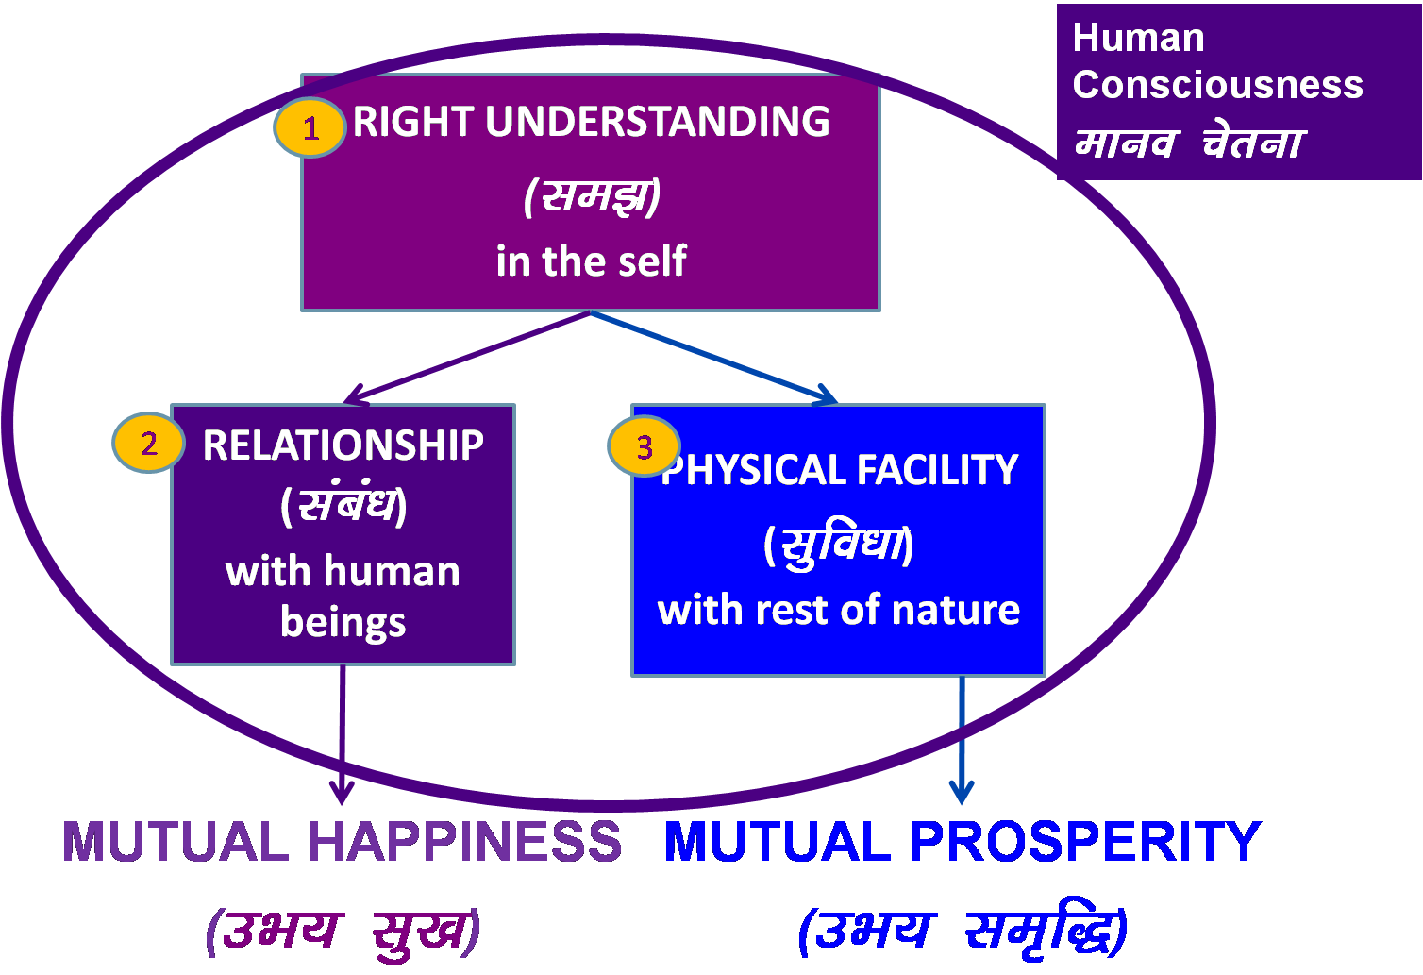
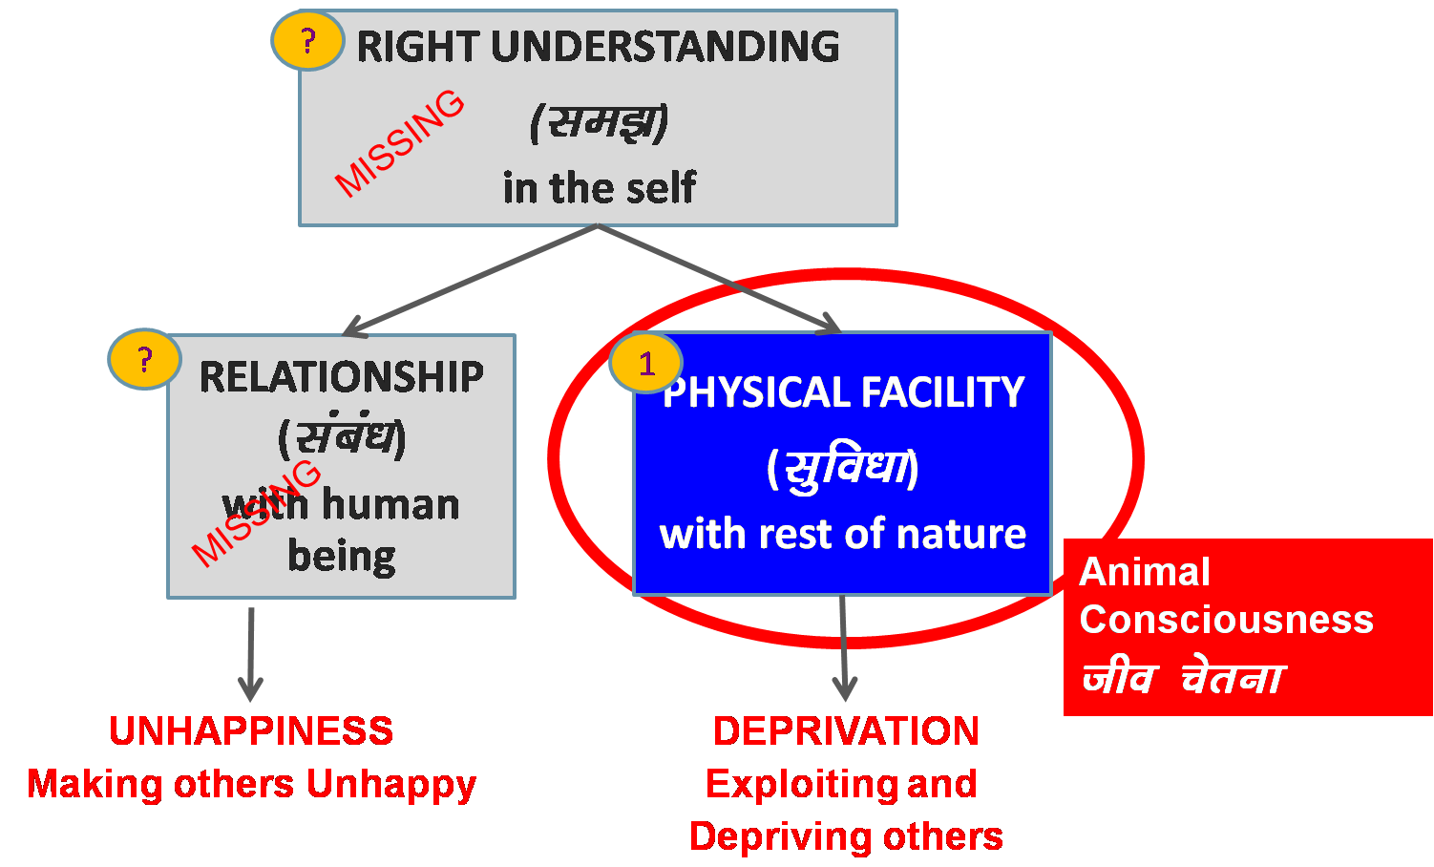
Role of Education – To Enable Transformation
The role of education is
To enable the transformation to human consciousness
To facilitate the development of
the competence to live with
definite human conduct
One’s education starts in the family, then goes on in school, college...
It is influenced by media... role models in society...
Transformation& Progress
laØe.k&fodkl
Notes:
Is role education is just Good job?

Slide 4
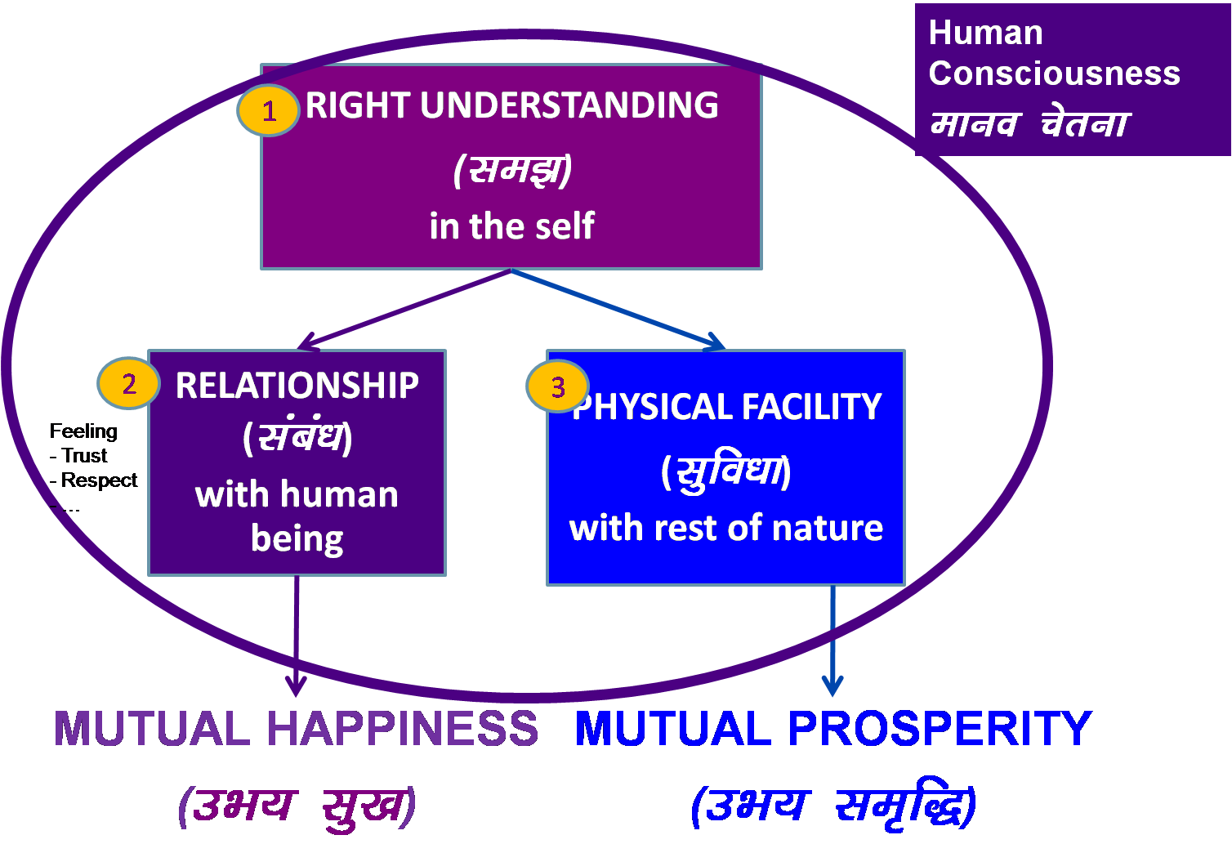
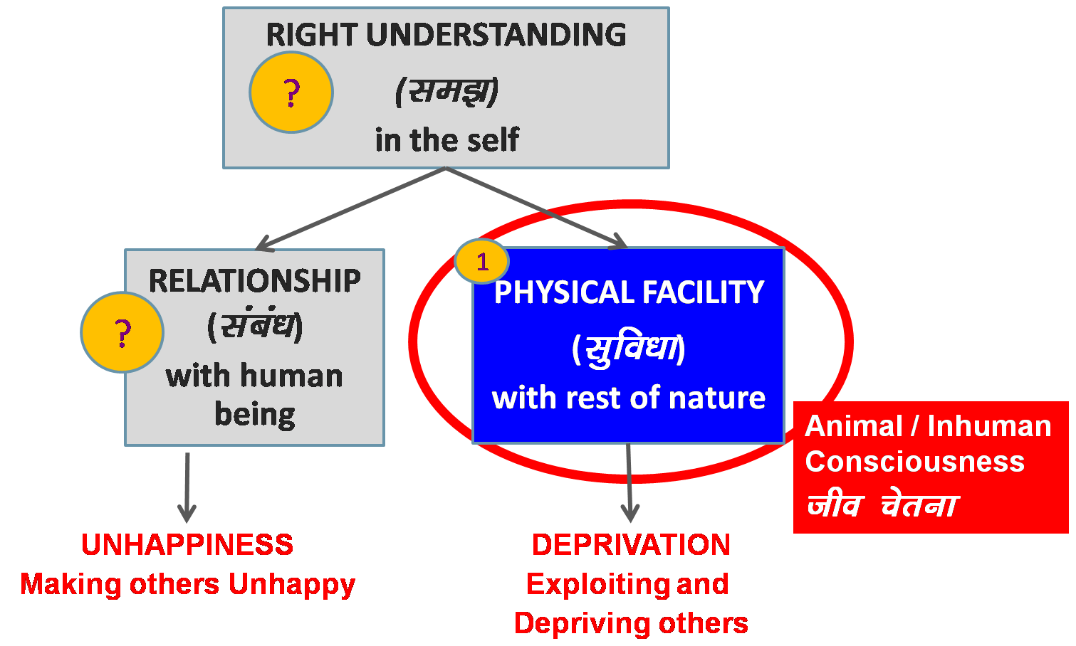
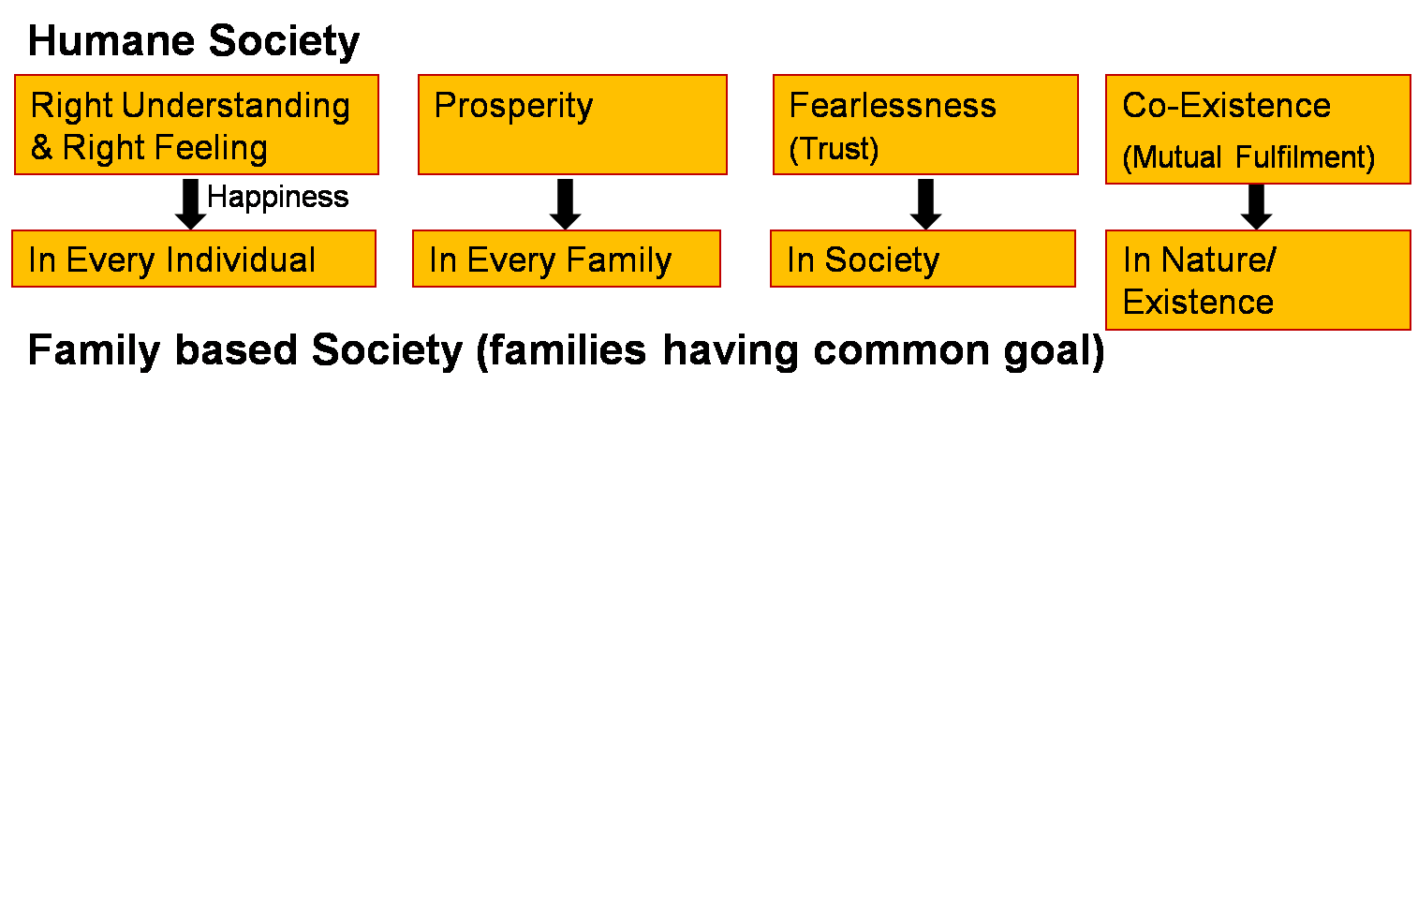
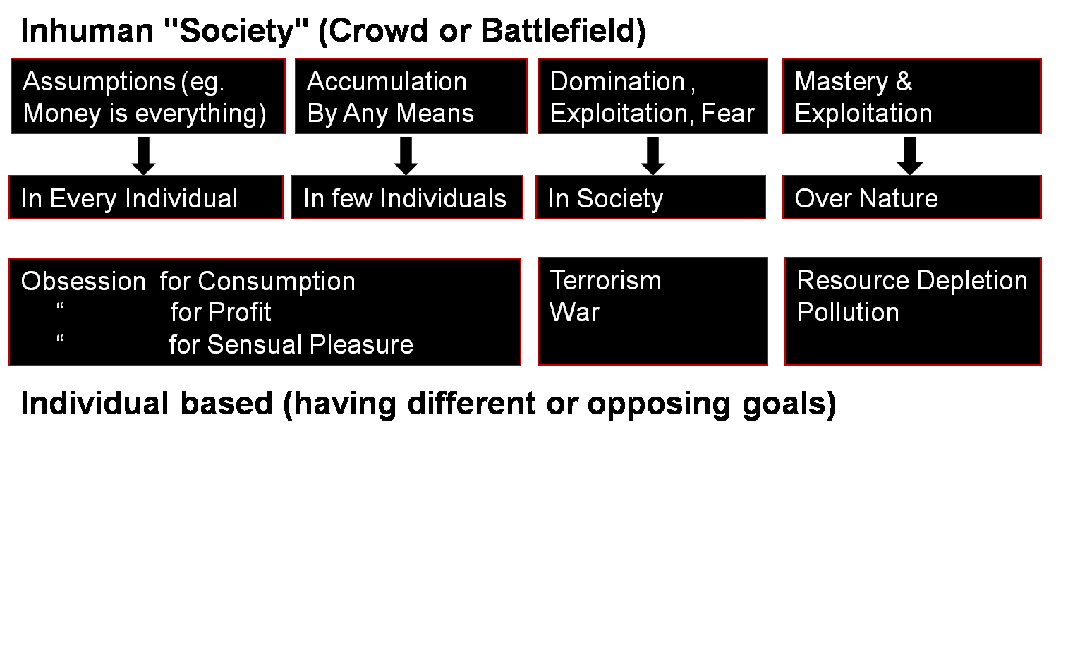
Living with Human Consciousness 🡪 Humane Family, Humane Society
Living with Animal Consciousness 🡪 Inhuman Family, Inhuman Society
Transformation& Progress
laØe.k&fodkl
Role of Education:
Personal transformation
Societal transformation

Slide 5
Values Human Values Universal Human Values

Slide 6
Value
What is valuable = value
The context is always the larger order
Value has to do with the participation in the larger order
E.g. A piece of chalk is a unit
A classroom is the larger order
The value of chalk is that it can be used to write on the blackboard
The participation in the larger order is also its role in the larger order
E.g. The role of chalk is to help write on the blackboard

Slide 7
Human Values
Value / role of a human being is its participation in the larger order
E.g. My role in living with the other human being is to ensure the feeling of respect in the relationship
Interestingly, I feel happy in fulfilling my role; and it is fulfilling for the other as well!
E.g. I feel happy when I have a feeling of respect
The other feels happy when I express respect to him
It is worth understanding, worth thinking about, worth doing
In nature, every unit is participating with every other unit in a mutually fulfilling manner (except human beings without right understanding)
E.g. The air, water, soil, plants, trees, animals, birds…
The role of human being is to live in harmony in the larger order
(i.e. ensure mutual fulfilment)
For this, human being has to understand harmony at every level of being

Slide 8
Human Values, Role of Human Being in the Larger Order
Individual
I have a role within myself
(eg. ensuring happiness in the self and health in the body)
Family
I have a role in my family
(eg. ensuring feeling of relationship and prosperity)
Society
I have a role in the society
(eg. to participate in social systems for ensuring justice, peace and harmony)
Nature/Existence
I have a role in nature/existence
(eg. mutual fulfilment with rest of nature)

Slide 9
Deciding Our Values
Do you want to be able to decide on your own right?
or
Do you want somebody else to decide for you?
(this somebody may be a group of people, it may be the society or the education system, etc.)
If you are not able to decide on your own right then:
Someone else is programming you (deciding what is valuable and what is not valuable for you)
Unconsciously you keep accepting those things as values
You get busy with how to implement them, how to realize them and materialize them

Slide 10
Values Decided by the Other
Eg. In a professional college, many first-year students start to use foul language within a very short time
They are made to assume that this sort of language is one of the indicators of their freedom, of their own progress to manhood… and they adopt it as a new value
Similarly, with sleeping late and getting up late… and so many things
Did they decide it for themselves?
Did it just happen “unconsciously”, without being aware of it?
Is it worth for them? Is it fulfilling for them?
Is it fulfilling for others (like their family members)?
So, if we are unable to decide on our own right, we are programmed by the other; our values are decided by someone else

Slide 11
Deciding Human Values on Our Own Right
Would we decide on the basis of whatever we like, whatever we believe?
If we decide in this manner, human values will be different for different people
Or is there some definite, existential basis, something we can understand, something we can be assured about, something that ensures mutual fulfilment in living?
If this is the case, then there is a possibility that human values are universal, they are the same for all of us
Value education is about exploring into this possibility

Slide 12
Components of Human Education
Understanding What to do, Values Value Education
Learning How to do, Skills Skill Development
Doing Skills guided by Values
Are both, values and skills, required?
Both are required; Values and skills are complementary to each other
If both are required, then what is the priority?
Values (what to do) first, then skills (how to do), but both are required
What is the state in present-day education?
Education has become skill-biased. There is a need to make appropriate changes

Slide 13
Guidelines for Value Education
Universal
The content needs to be universal – applicable to all human beings and be true at all times, all places
It should not depend on sect, creed, nationality, race, gender, etc.
Rational
It must be amenable to logical reasoning
It should not be based on blind beliefs
Verifiable
The student should be able to verify the values on one’s own right
Should not be asked to believe just because it is stated in the course
Leading to Harmony
Values have to enable us to live in peace and harmony within our own self as well as with others (human being and rest of nature)

Slide 14
Content of Value Education
Holistic, All Encompassing
Covers all dimensions of being, as an Individual:
Thought
Behaviour
Work
Understanding/Realization
Eg. In Thought – we want to have clarity (a state of resolution, solution) NOT confusion (a state of problem)
Covers all levels of living:
Individual (human being)
Family
Society
Nature/Existence
Eg. As a Family, Society – we want Fearlessness / Trust
NOT fear (due to mistrust / opposition)

Slide 15
Process of Value Education
Universal
The content needs to be universal – applicable to all human beings and be true at all times, all places
It should not depend on sect, creed, nationality, race, gender, etc.
Rational
It must be amenable to logical reasoning
It should not be based on blind beliefs
Verifiable
The student should be able to verify the values on one’s own right
Should not be asked to believe just because it is stated in the course
Leading to Harmony
Values have to enable us to live in peace and harmony within our own self as well as with others (human being and rest of nature)

Slide 16
Process of Value Education
Whatever is said is a Proposal (Do not assume it to be true or false)
Verify it on Your Own Right – on the basis of our Natural Acceptance
It is a process of Dialogue
A dialogue between me and you, to start with
It soon becomes a dialogue within your own self
between what you are and what you really want to be (your natural acceptance)
The purpose of this workshop is to initiate this internal dialogue
izLrko gS ¼ekuas ugha½
tk¡pas & Lo;a ds vf/kdkj ijA
viuh lgt LohÑfr ds vk/kkj ijA
;g laokn dh izfØ;k gSA
;g laokn vkids vkSj esjs chp 'kq: gksrk gS] fQj vki eas pyus yxrk gSA
More

Slide 17
FAQ

Slide 18
Analysis of the Current State
Little interest in learning, unsure of what they wish to do in life
– even in premier institutions
Under tremendous pressure (parents, peers, TV...)
Manifest problems – self-centredness, acute competitiveness and insensitivity towards others, indiscipline and violence, addiction to alcohol, drugs etc., depression, suicide...
Graduates tend to join into a blind race for wealth and position. Their skills are often used only to accumulate wealth
Other aspects of life including relationships in family and work place, understanding of society and public good, remain neglected
Use and misuse of skills…

Slide 19
Some of Your Questions May Be…
Is value education the same as moral education? Knowing, assuming
Is there a need for values in today's world? The need is urgent
Can values be taught in the classroom? We have to facilitate
the student to discover values
within themselves
Is this teaching effective? In the experiments
so far, the results
have been quite
encouraging
Can our teachers teach it? Preparation required
Will our students be interested in it? Communication
We need to explore into these and such other questions…

Slide 20
Value Education Moral Education
Proposal, Self Verification
Understanding, Knowing
Self-motivated, Unconditional
- Self-discipline (Lo&vuq”kklu)
Self-organised (Lora=rk)
Do’s & Don'ts
Preconditioning, Assuming
Externally Motivated, Conditional
Fear / Incentive
Enslaved (ijra=rk)

Slide 21
Some of Your Questions May Be…
There is a need for value education, but can we deliver it in today’s corrupt environment?
What can one teacher do? We have to follow the system
There is no space in the curriculum. Already we are overburdened
The colleges are there only to make money. What are we talking about values in such a corrupt system?

